Slide 1
A comparison study between Heart Rate obtained from Fingertip and Wrist position
Ayush Dhananjay Modani
MD Kamrul Hasan Foysal
Under Guidance of Dr. Jo Woon chong
Date : 29th November 2018

Slide 2
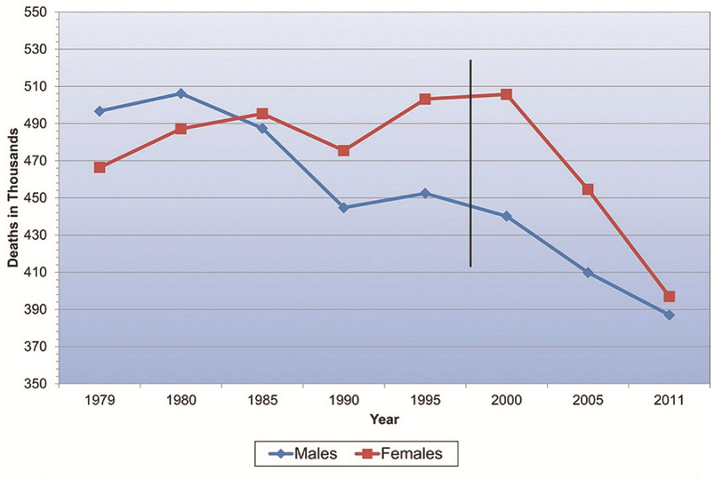
Why heart rate monitoring is important??
Heart Diseases Problems rising day by day
807,775 deaths in just 2014
14% increase in deaths from (2009-2011) to (2012-2014)

Slide 3
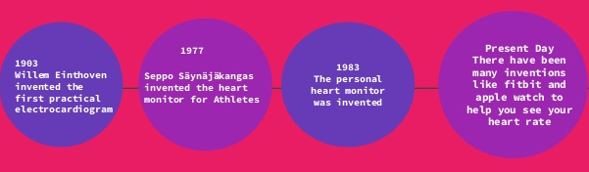
Heart Monitoring Devices

Slide 4
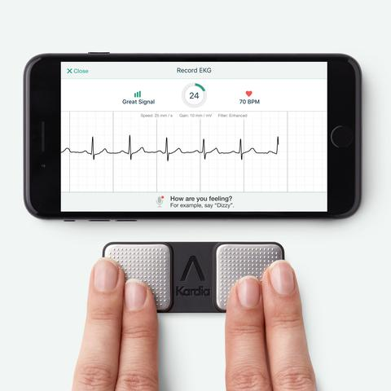
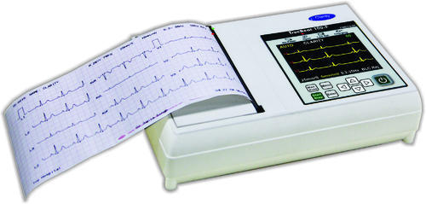
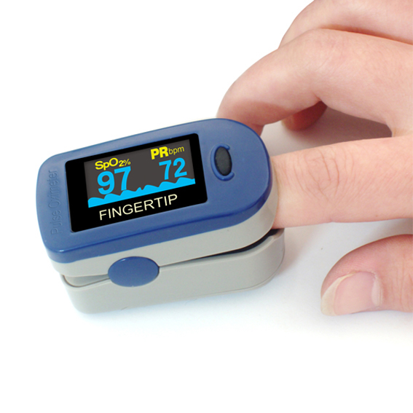
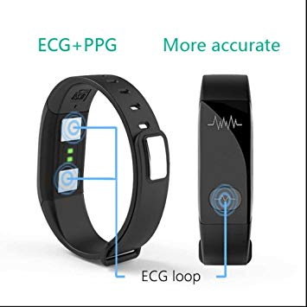
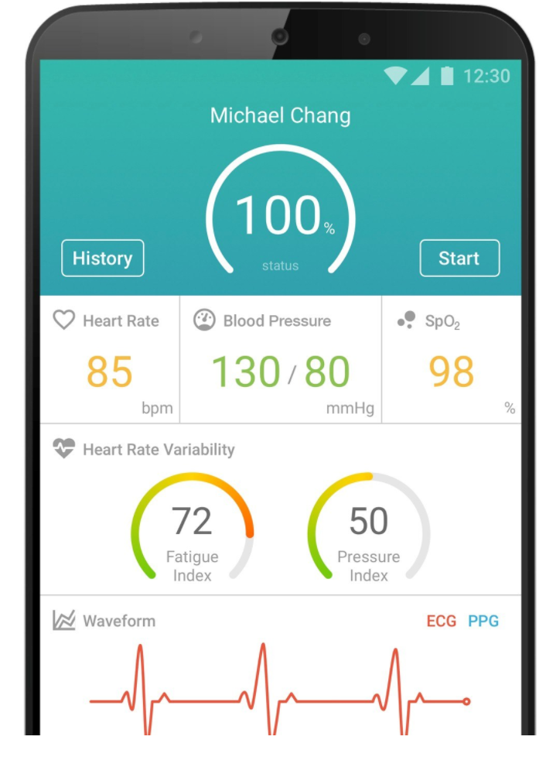
Kardia
ECG
Pulse Oximeter
Smartwatch/Smartband
Smartphone

Slide 5
Can the extraction position (place) in the body affects the heart rate??

Slide 6
Lets compare the new technology (smartWatch and Smartphone) with the Golden standard

Slide 7
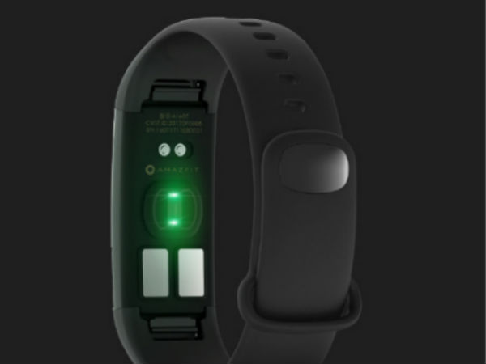
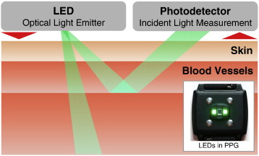
Smartwatch/fitness band Heart Rate working

Slide 8
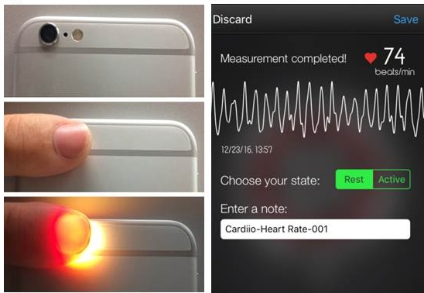
Smartphones Herat rate working

Slide 9
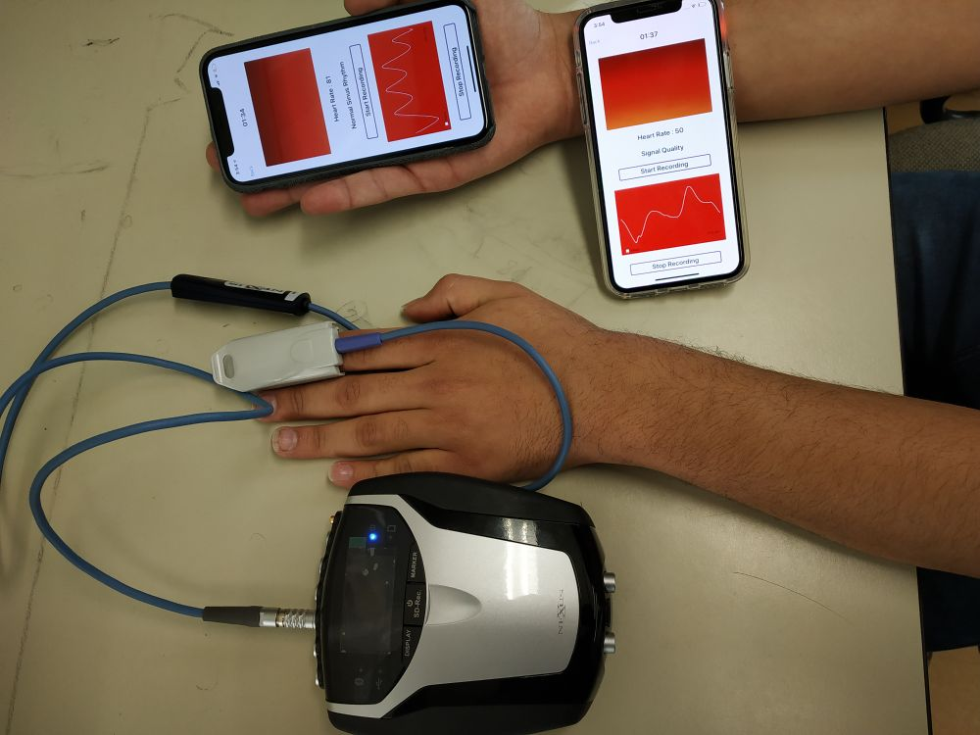
Methodology

Slide 10
Flow Diagram
Intensity Method
Place Components as shown and Start Recording
Curve-based Method
Smartphone Application
After 2min note the file name
Start the Application
Extract Images from Video
Extract the file in MATLAB and process it
Capture the frames in Real-Time
Apply Bit Arrangement 888-565
Extract the Green Intensity from the images extracted
Apply Edge Detection and Smoothing
Filter the Signal using Moving Averaging Filter
Save the intensity as a text file
Use Curve Selection for PPG detection
Find the Peaks from the signal
Plot the intensity
Plot the Signal with Peaks
Apply same for next Images
Terminate Application after 2min
Calculate Heart Rate using Peaks and Average it
Plot the PPG obtained

Slide 11
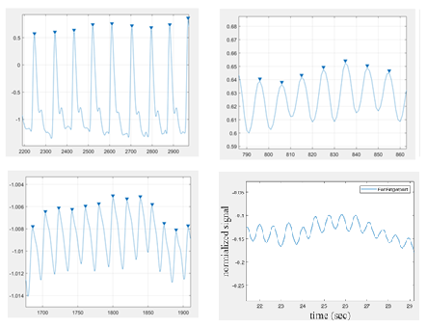
Result - PPG Signal
PPG from Nexus Device
PPG from Fingertip using Intensity Method
PPG from Wrist using Intensity Method
PPG from Fingertip using Curve-based Method

Slide 12
Results – Heart Rate Comparison
Subject No | Age | Heart Rate from Fingertip |  | Heart Rate from Wrist |  | Heart Rate from NeXus
 |  | Heart Rate (IM) | Heart Rate (CM) | Heart Rate (IM) | Heart Rate (CM)
1 | 23 | 72 | 75 | 75 | 75 | 71.7757
2 | 27 | 64.2857 | 66.6666 | 62.0689 | 64.2857 | 66.2069
3 | 29 | 81.8182 | 85.7142 | 85.7143 | 81.8182 | 80.8421
4 | 21 | 58.0645 | 58.0645 | 60 | 62.0689 | 59.0769
5 | 19 | 62.0609 | 64.2857 | 60 | 60 | 60.9524
6 | 22 | 72 | 75 | 90 | 85.7143 | 73.1429
7 | 21 | 62.0689 | 62.0689 | 60 | 62.0689 | 61.44
8 | 18 | 81.8182 | 78.2608 | 78.2608 | 81.8182 | 80
9 | 26 | 72 | 75 | 72 | 72 | 73.8462
10 | 23 | 90 | 90 | 94.7368 | 90 | 90.3529

Slide 13
Results – Heart Rate Comparison

Slide 14
Results - Error
Subject No | NeXus Heart Rate | Error in Heart Rate from Fingertip |  |  |  | Error in Heart Rate from Wrist
 |  | Error in Heart Rate (IM) |  | Error in Heart Rate (CM) |  | Error in Heart Rate (IM) |  | Error in Heart Rate (CM)
 |  | In bpm | % | In bpm | % | In bpm | % | In bpm | %
1 | 71.7757 | -0.2243 | 0.3125 | -3.2243 | 4.49219 | -3.2243 | 4.49219 | -3.2243 | 4.49219
2 | 66.2069 | 1.9212 | 2.901812 | -0.4597 | 0.69434 | 4.138 | 6.250104 | 1.9212 | 2.901812
3 | 80.8421 | -0.9761 | 1.20742 | -4.8721 | 6.02669 | -4.8722 | 6.02681 | -0.9761 | 1.20742
4 | 59.0769 | 1.0124 | 1.713699 | 1.0124 | 1.713699 | -0.9231 | 1.56254 | -2.992 | 5.06459
5 | 60.9524 | -1.1085 | 1.81863 | -3.3333 | 5.46869 | 0.9524 | 1.562531 | 0.9524 | 1.562531
6 | 73.1429 | 1.1429 | 1.562558 | -1.8571 | 2.539 | -16.8571 | 23.0468 | -12.5714 | 17.1875
7 | 61.4400 | -0.6289 | 1.0236 | -0.6289 | 1.0236 | 1.44 | 2.34375 | -0.6289 | 1.0236
8 | 80.0000 | -1.8182 | 2.27275 | 1.7392 | 2.174 | 1.7392 | 2.174 | -1.8182 | 2.27275
9 | 73.8462 | 1.8462 | 2.500061 | -1.1538 | 1.56244 | 1.8462 | 2.500061 | 1.8462 | 2.500061
10 | 90.3529 | 0.3529 | 0.39058 | 0.3529 | 0.39058 | -4.3839 | 4.85197 | 0.3529 | 0.39058
Average Error |  |  | 1.570361 |  | 2.608522 |  | 5.481076 |  | 3.860297

Slide 15
Results – Error Comparison

Slide 16
Result – Error comparison

Slide 17
conclusion
Heart Rate depends upon position from which data is obtained
Heart Rate from Fingertip is more Accurate than Heart Rate from Wrist
Intensity Method Heart Rate from Fingertip Images is having accuracy of 98%
Heart Rate from Curve-based Method using Fingertip Images is having accuracy of 97%
Intensity Method Heart Rate from Wrist Images is having accuracy of 94%
Heart Rate from Curve-based Method using Wrist Images is having accuracy of 96%

Slide 18
References
1. Accuracy of smartphone apps for heart rate measurement, Thomas Coppetti, Andreas Brauchlin, Simon Muggler, European Journal of Preventive Cardiology 2017, Vol. 24(12) 1287–1293 The European Society of Cardiology 2017
2. https://www.mindmedia.com/de/produkte/nexus-10-mkii/
3. https://en.wikipedia.org/wiki/Ballistocardiography
4. The emerging field of mobile health Steven R. Steinhub, Evan D. Muse, and Eric J. Topo, HHS Public Access Author manuscript Sci Transl Med. Author manuscript; available in PMC 2016 February 10
5. Mobile Devices and Apps for Health Care Professionals: Uses and Benefits C. Lee Ventola, MS, P T. 2014 May; 39(5): 356–364., PMCID: PMC4029126, National Institutes of Health
6. Evidence assessing the diagnostic performance of medical smartphone apps: a systematic review and exploratory meta-analysis, Rahel Buechi,1 Livia Faes,2 Lucas M Bachmann,2 Michael A Thiel,1 Nicolas S Bodmer,2 Martin K Schmid,1 Oliver Job,1 Kenny R Lienhard3, BMJ Open 2017;7: e018280. doi:10.1136/ bmjopen-2017-018280
7. A. S. M. Mosa, I. Yoo, L. Sheets, "A systematic review of healthcare applications for smartphones", BMC Med. Inf. Decision Making, vol. 12, pp. 67, Jul. 2012.
8. Yadav, D.; Gupta, P.; Kaur, G.; Singh, J.; Gandh, I.M.; Singh, A. Implementing Edge Detection for Medical Diagnosis of A Bone in MATLAB. In Proceedinds of the International Conference on Computational Intelligence and Communication Networks (CICN), Mathura, India, 27–29 September 2013; pp. 270–274.
9. Zaman R, Cho CH, Hartmann-Vaccarezza K, et al. Novel fingertip image-based heart rate detection methods for a smartphone. Sensors. 2017;17(2):E358.
10. del Rosario MB, Redmond SJ, Lovell NH. Tracking the evolution of smartphone sensing for monitoring human movement. Sensors. 2015;15:18901–18933.
11. R. Zaman, C.H. Cho, K. Hartmann-Vaccarezza, T.N. Phan, G. Yoon, J.W. Chong, "Novel Fingertip Image-Based Heart Rate Detection Methods for a Smartphone", Sensors, vol. 17, no. 2, pp. 358, 2017
12. R. Zaman, C.H. Cho, Y. Kim, J.W. Chong, "A novel heart rate monitoring method using a smartphone", Proc. IEEE Healthcare Innovation Point-Of-Care Technologies (HI-POCT) Conference, pp. 5-8, 2016.
13. R.J. Duro, F.L. Pena, "Smartphone-based Photoplethysmogram Measurement" in Digital Image and Signal Processing Measurement Systems, Aalborg, Denmark:River Publisher, pp. 358, 2017.

Slide 19
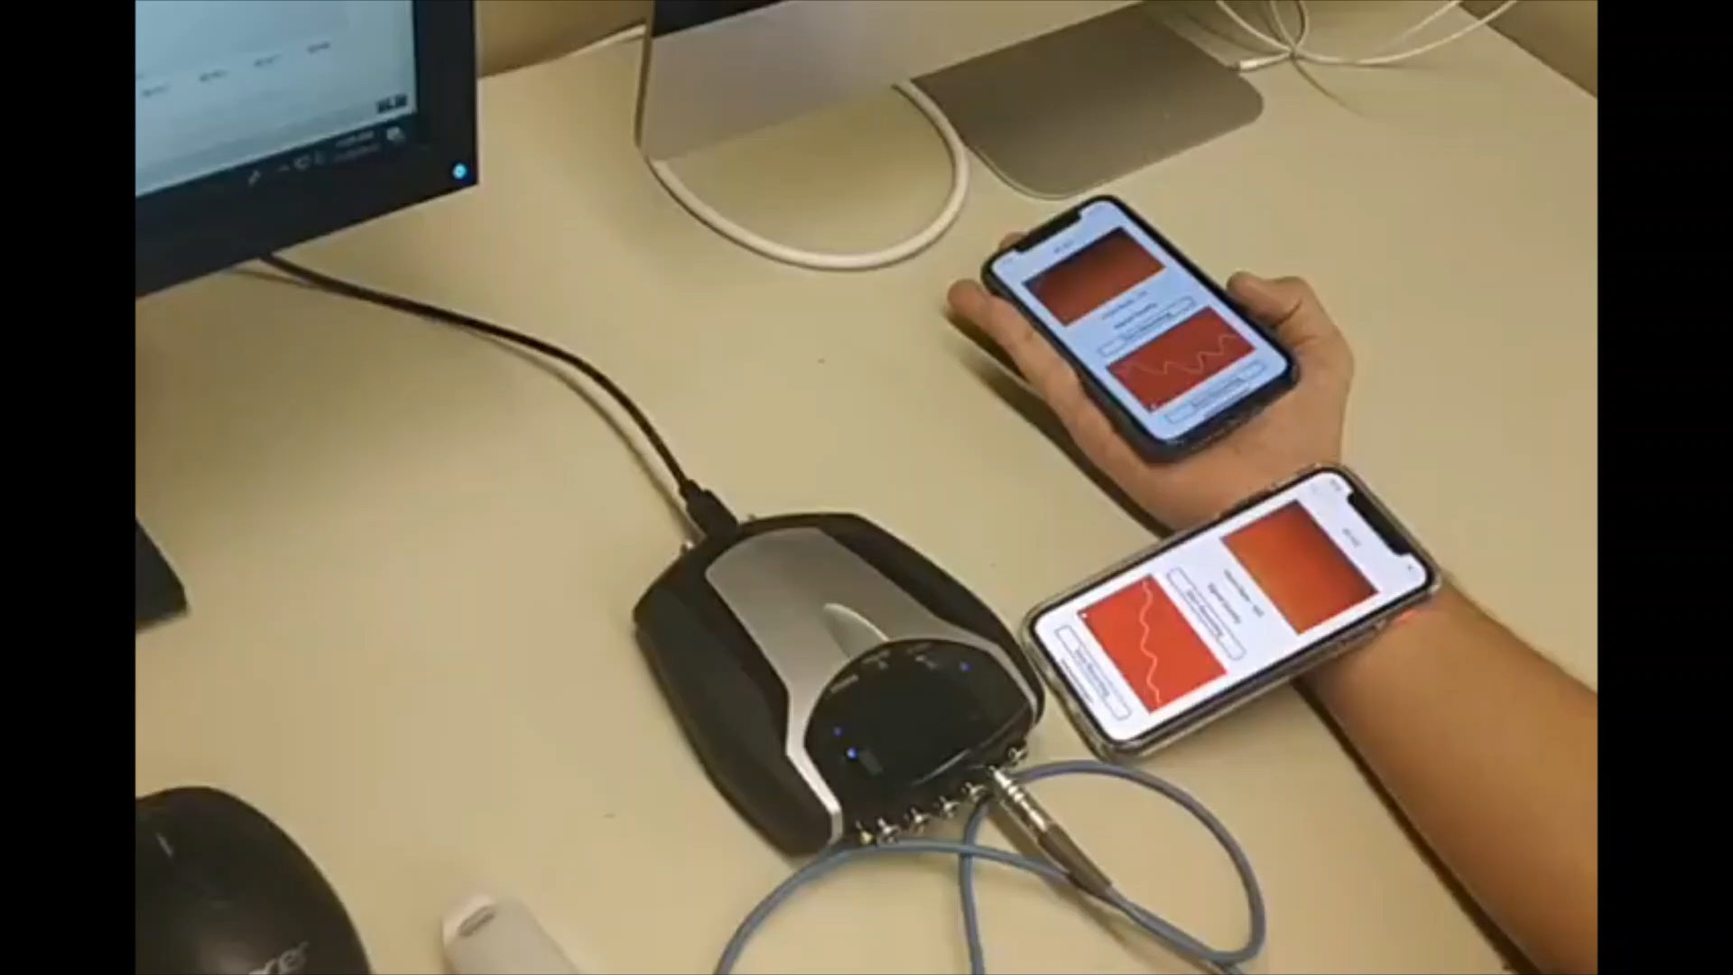
Demo

Slide 20
Any questions?

Slide 21
Thank You

